Slide 1
Predictive Maintenance of Aircraft engines
By
M.Sumedhaa-160118737019
G.Usha-160118737021
Batch No.: CBIT/IT/2021-2022/111
Project Guide : S.Rakesh

Slide 2
CONTENTS
Introduction
Literature Survey
System Requirements
Methodology
System Design
DataSet
Algorithms
Implementation
Result
Conclusion

Slide 3
INTRODUCTION
MOTIVATION
Predictive maintenance determines the condition of equipment and predicts when maintenance should be performed.
In predictive maintenance scenarios, data is collected over time to monitor the state of equipment. The goal is to find patterns that can help to predict and ultimately prevent failures.
In most industries,particularly aviation industries deal with this problem by being pessimistic and through precise maintenance programs which often end up doing the maintenance before it is needed,thereby underutilizing the components which is not an optimal solution from a cost perspective.
So,the aim of predictive maintenance in aviation is first to predict when an engine failure might occur, and secondly, to prevent the occurrence of the failure by performing maintenance.

Slide 4
PROBLEM STATEMENT
Failure prediction is a major topic in predictive maintenance in many industries. Aircrafts are particularly interested in predicting equipment failures in advance so that they can enhance operations and reduce delays.Observing engine's health and condition through sensors and telemetry data is assumed to facilitate this type of maintenance by using machine learning algorithms.

Slide 5
LITERATURE SURVEY
S.No. | Authors and Year | Journal | Title | Methodology | Limitations or Future Scope
1 | AdePitra Hermawan, Dong-Seong Kim and Jae-Min Lee.2020 | IEEE | Predictive Maintenance of Aircraft Engine using Deep Learning Technique | In this paper LSTM algorithm is used in the learning the behavior of the historical data and providing the accurate information about the time to failure of the system. | Only RUL has been predicted,the cycle in which the engine failure might occur is not predicted for more accuracy.
2 | Pengcheng Xia , Yixiang HuangPeng,Li,Chengliang Liu, and Lun Shi 2022 | IEEE Transactions On Industrial Informatics. | Fault Knowledge Transfer Assisted Ensemble Method for Remaining Useful Life Prediction | Paper represents a novel fault information assisted RUL prediction method based on a convolutional long Short-term memory (LSTM) ensemble network. | It is assumed that a fault dataset containing all potential fault types is available,they have not considered historical data of engine failure.
3 | Deepankar Singh, Mithilesh Kumar, K.V. Arya and Sunil Kumar 2020 | IEEE Transactions on Aerospace and Electronic Systems | Aircraft Engine Reliability Analysis using Machine Learning Algorithms. | Paper presents ten different machine learning algorithms for predicting the RUL of an engine. | Deep learning models can be used for better prediction accuracy.

Slide 6
SYSTEM
REQUIREMENTS
SOFTWARE REQUIREMENTS:
Operating systems: Windows 10.
Python version 3.9.4
Google Colab
HARDWARE REQUIREMENTS:
Input device (mouse / trackpad)
64 bit processor
Sufficient RAM to run the program

Slide 7
METHODOLOGY
The project objective is to enhance the maintenance operations by applying data science techniques and machine learning algorithms for predicting more accurate maintenance requirements.
By considering the aircraft engine’s sensor values over time, the machine learning algorithm can learn the relationship between the sensor values and changes in sensor values to the historical failures in order to predict failures in the future.

Slide 8
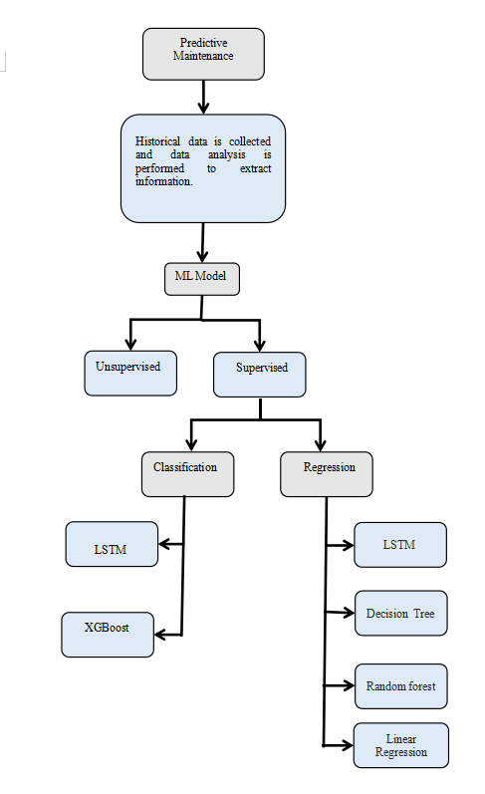
SYSTEM
DESIGN

Slide 9
DATA SET
The dataset for this project contains training data,test data and truth data which is taken from Kaggle (https://www.kaggle.com/maternusherold/pred-maintanance-data)
Following are the parameters:
id: is the engine ID, ranging from 1 to 100
cycle: per engine sequence, starts from 1 to the cycle number where failure had happened.
operational settings- setting 1 to setting 3
sensors measurements-s1 to s21

Slide 10
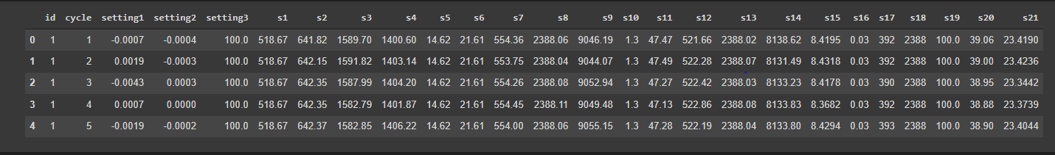
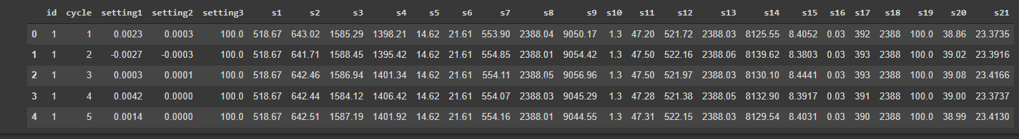
Dataset-1
Snippet of the Training data and testing data

Slide 11
Data Preprocessing
First step is to generate labels for the training dataset and testing dataset which are Remaining Useful Life (RUL), label1 and label2
MinMax normalization (from 0 to 1) :cycle column is also used for training so we will also include the cycle column. Here, we normalize the columns in the training dataset and testing dataset.

Slide 12
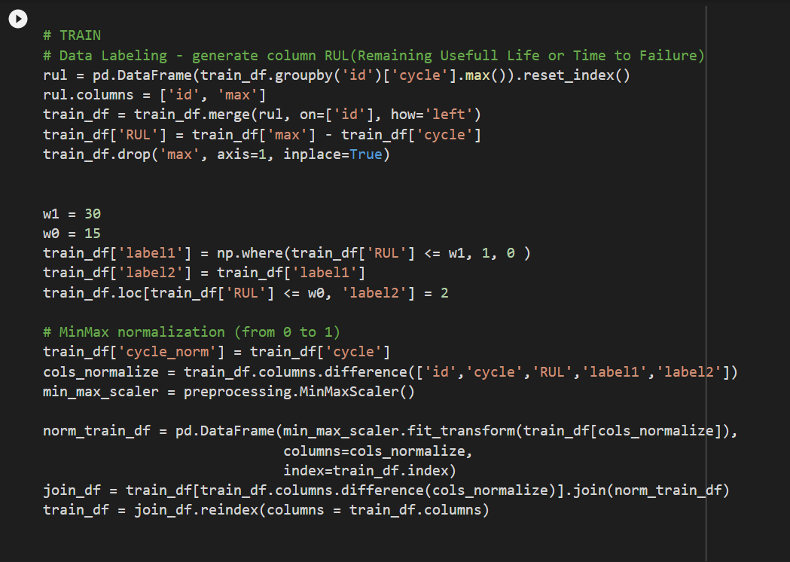
Snippet for data preprocessing-Training data

Slide 13
ALGORITHMS
Algorithms used for this project are to find out RUL(remaining useful lifetime) of the engine and to predict whether engine will fail or not.
Remaining useful lifetime:It is the number of cycles between that cycle and the last cycle of the same engine.
Engine failure:If the remaining cycles is less than specific number of cycles,the engine will fail in this period, otherwise the engine is fine.

Slide 14
IMPLEMENTATION
Algorithms for predicting RUL
The following algorithms are implemented to predict RUL(remaining useful lifetime):
LSTM
Multiple Linear Regression
Random forest
Decision Tree

Slide 15
Multiple Linear Regression: A statistical method of analysis that estimates the relationship between one or more independent variables and a dependent variable; the method estimates the relationship by minimizing the sum of the squares in the difference between the observed and predicted values of the dependent variable configured as a straight line or hyperplane.
Decision Tree: It learns in a hierarchical fashion by repeatedly splitting the dataset into separate branches that maximize the information gain of each split. In regression tree, the value obtained by terminal nodes in the training data is the mean response of observation falling in that region.
Random Forest: An ensemble learning method for classification, regression and other tasks, that operate by constructing a multitude of decision trees at training time and outputting the class that is mean prediction (regression) of the individual trees.

Slide 16
LSTM
Long Short Term Memory networks – usually called “LSTMs” – are a special kind of RNN, capable of learning long-term dependencies.
LSTMs are explicitly designed to avoid the long-term dependency problem.
The key to LSTMs is the cell state.
The LSTM does have the ability to remove or add information to the cell state, carefully regulated by structures called gates.
An LSTM has three of these gates, to protect and control the cell state.

Slide 17
LSTM
In the proposed system for regression, LSTM layer with 100 units is used for the first layer to process the input data
Followed by another LSTM layer with 50 units.
Dropout layer with 0.2 is also applied after each LSTM layer to control overfitting.
Final layer is a Dense output layer with single unit and linear activation.

Slide 18
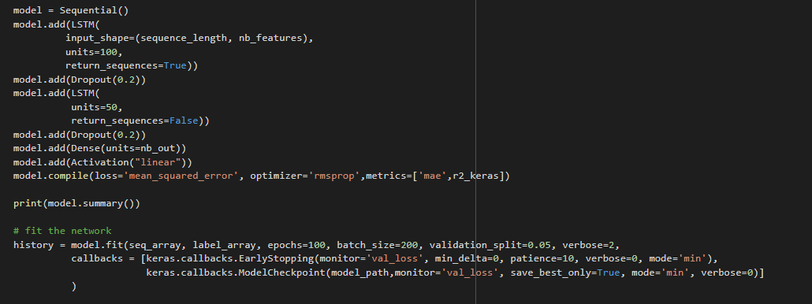
IMPLEMENTATION
Snippet of the LSTM algorithm

Slide 19
IMPLEMENTATION
Comparison of different algorithms for RUL on dataset1
ALGORITHMS | MEAN ABSOLUTE ERROR(MAE) | RMSE
LSTM | 12.77 | 18.65
Random forest | 23.17 | 28.63
Decision Tree | 24.32 | 32.09
Multiple Linear Regression | 25.59 | 32.04

Slide 20
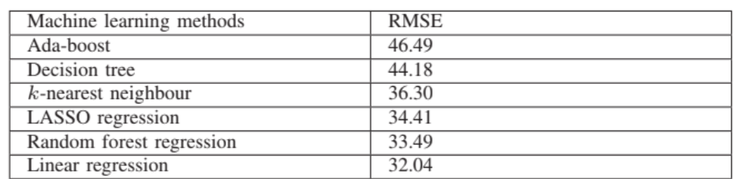
Base Paper Results for predicting RUL

Slide 21
IMPLEMENTATION
Comparison of different algorithms for RUL on dataset2
ALGORITHMS | MEAN ABSOLUTE ERROR(MAE) | RMSE
LSTM | 20.1 | 20.4
Random forest | 25.0 | 32.5
Decision Tree | 26.3 | 35.0
Multiple Linear Regression | 27.4 | 33.9

Slide 22
Algorithms for predicting engine failure
The following algorithm namely LSTM is implemented to predict whether engine will fail or not.
LSTM:Long short-term memory (LSTM) is a deep recurrent neural network architecture used for classification of time-series data.Recurrent Neural networks like LSTM generally have the problem of overfitting. Dropout can be applied between layers using the Dropout Keras layer.

Slide 23
LSTM
In the proposed system for classification,the first layer is an LSTM layer with 100 units followed by another LSTM layer with 50 units.
Dropout is also applied after each LSTM layer to control overfitting.
Final layer is a Dense output layer with single unit and sigmoid activation since this is a binary classification problem.

Slide 24
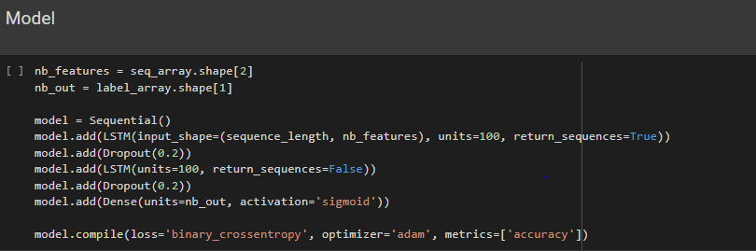
IMPLEMENTATION
Snippet of the LSTM algorithm

Slide 25
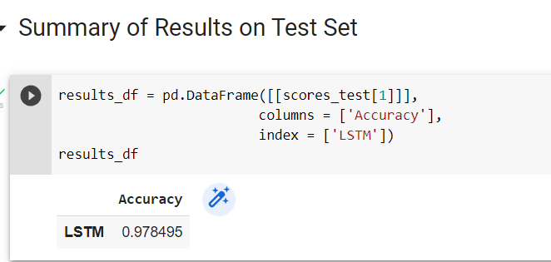
IMPLEMENTATION
Output of LSTM Algorithm

Slide 26
CONCLUSION
Predictive Maintenance of Aircraft Engines detects the anomalies and failure patterns and provides early warnings.
By applying machine learning algorithms to historical dataset of engines,the project can predict rul and engine fails or not for aircraft engines.
Among various algorithms applied on the datasets Long Short Term Memory(LSTM) has given better results for MAE,RMSE and accuracy for predicting RUL and engine failure respectively.

